Slide 1

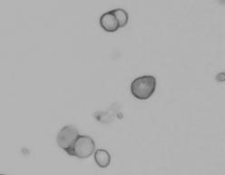
Single Cell Sample Preparation
Diana Burkart-Waco, PhD
dburkart@ucdavis.edu
SRA at UC Davis DNATECH Core
https://dnatech.genomecenter.ucdavis.edu/

Slide 2
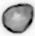
Overview
Why single cell?
Methods – SC isolation
Single cell isolation
Single nuclei
Methods - sample QC
Do I have single cells?
Are they alive?
Are they too big?
Did I isolate the correct cells?
Cell labeling
Single cell studies at DNA Tech

Slide 3
scRNA-seq

Slide 4
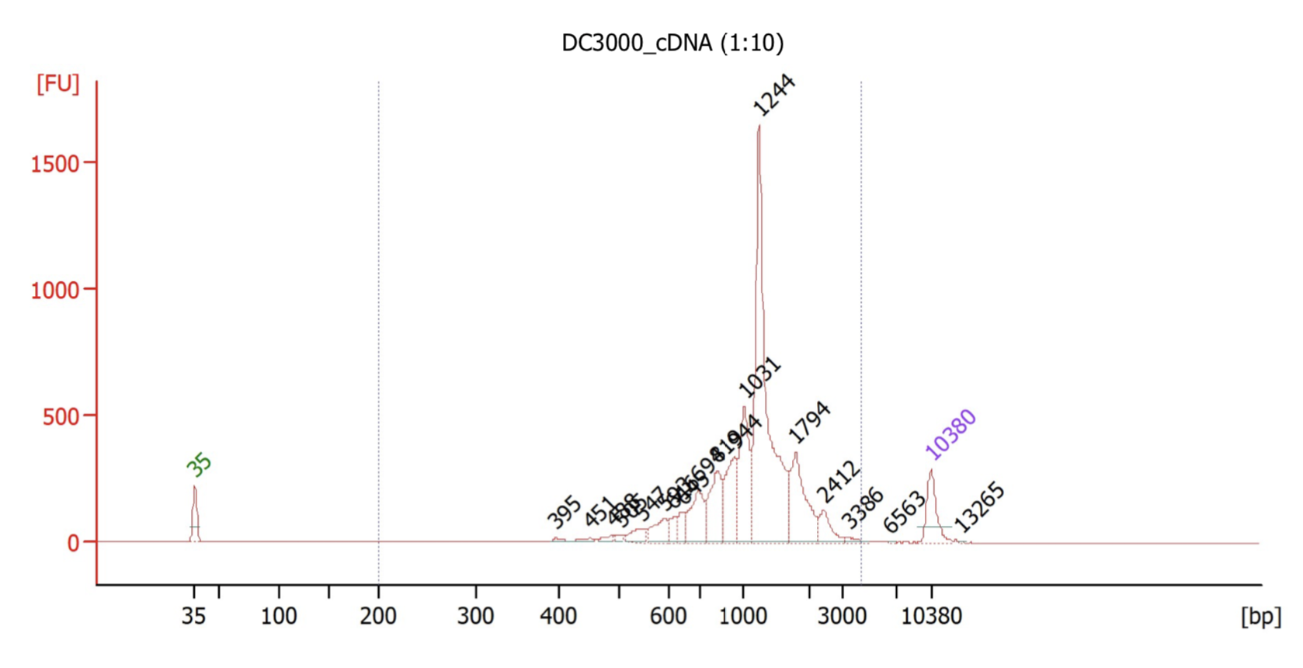
10X Genomics
Captures 100-10,000+ cells per sample.
Recovers up to ~65% of cells.
Low doublet rate.
(~0.9% per 1,000 cells).
40 micron size limit.
Expensive!

Slide 5
Alternative technologies
Homemade drop-seq.
Qiagen UPX.
SPLIT-seq.
Dolomite Nadia System.
Fluidigm.
And the list goes on…
Need both single cells and to maintain sample composition.

Slide 6
Overview
Why single cell?
Methods – SC isolation
Single cell isolation
Single nuclei
Methods - sample QC
Do I have single cells?
Are they alive?
Are they too big?
Did I isolate the correct cells?
Cell labeling
Single cell studies at DNA Tech

Slide 7
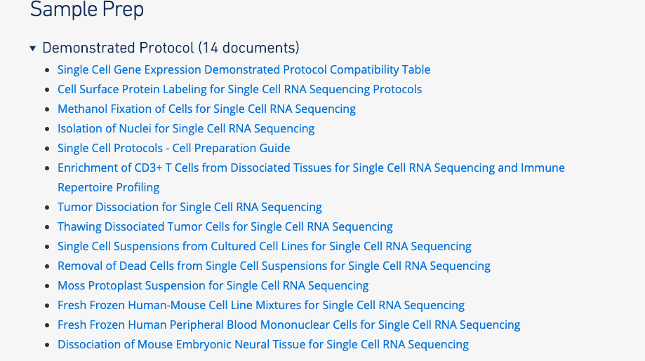
Cell isolation
Cell isolation guides available at:
https://www.support.10xgenomics.com/single-cell-gene-expression/sample-prep/
Cell isolation → biggest source technical variation.
Dissociation and preparation depends on cell type.

Slide 8



General Workflow
Tissue dissection
Fast, reliable, clean.
Mechanical mincing
Trituration, razor blade, etc.
Enzymatic breakdown
E.g. Trypsin, dispase, collagenase)
Often with agitation
Obtain cell interest (flow)
Remove dead cells (beads, etc.)
Cell enrichment
(optional)

Slide 9
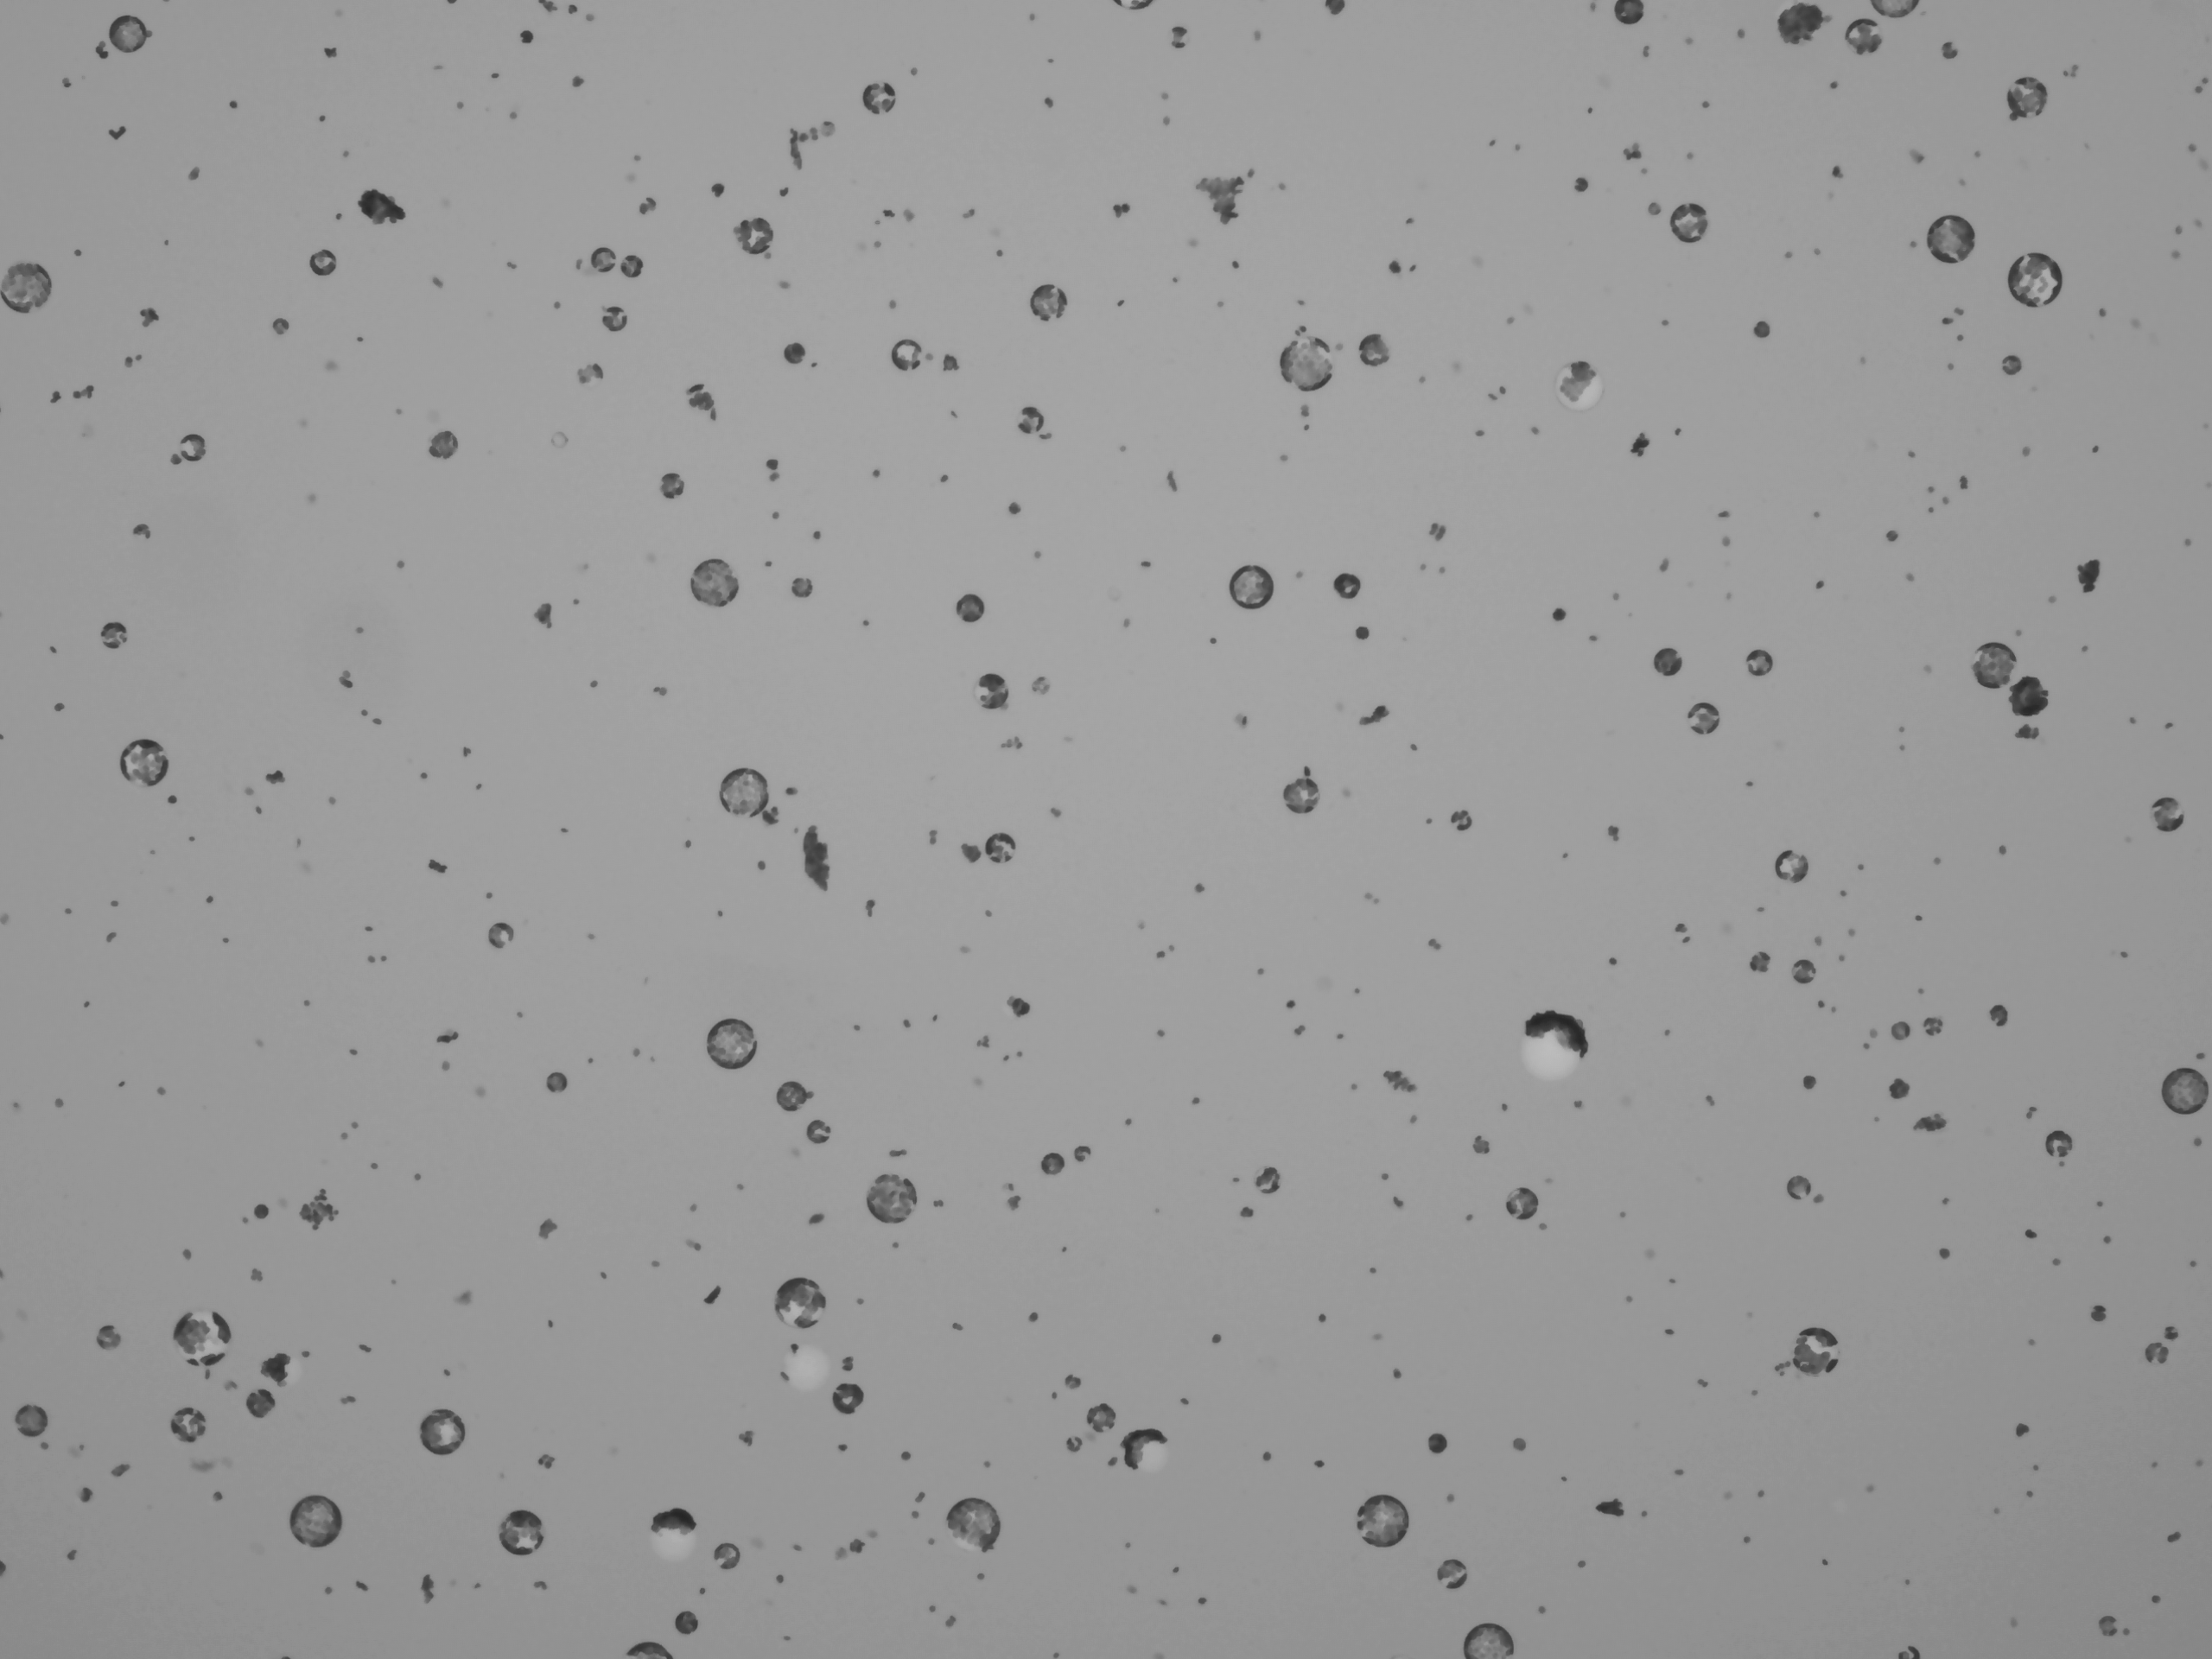
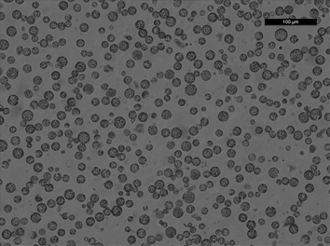
Tissue Dissociation
Many ways to dissociate tissue:
Mechanical
Enzymatic
Automated blending
Microfluidics devices
Considerations:
Speed
Consistency in results
Good representation of all cell types
Arabidopsis protoplasts
Same method, different days.

Slide 10

Factors Influencing Dissociation
Unfortunately, SC sample optimization is best achieved through trial and error…

Slide 11

Single cell vs. nuclei
Single cell captures more transcripts, but is a harder protocol.
When to use nuclei:
Cells cannot be harvested intact or viable (e.g. adipocytes, neurons).
Cells are too big for capture (e.g. cardiomyocytes).
Tissue frozen.
Tissue dissection
Detergent
Grinding
Cell lysis
Flow cytometry
Density Gradient
Nuclei purification

Slide 12
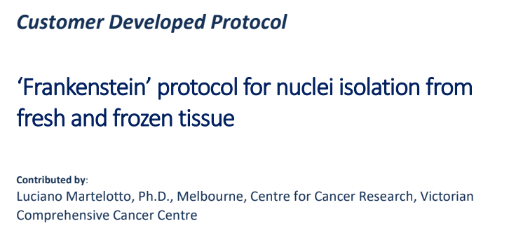
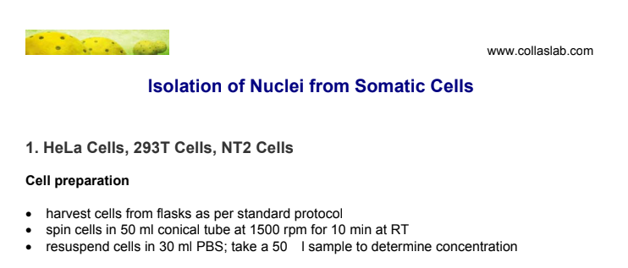
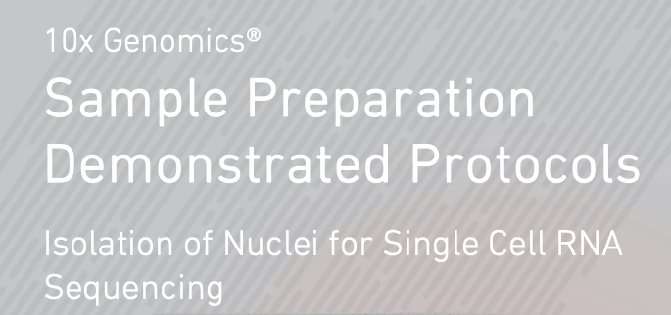
Many protocols available…
Start here:

Slide 13
Overview
Why single cell?
Methods – SC isolation
Single cell isolation
Single nuclei
Methods - sample QC
Do I have single cells?
Are they alive?
Are they too big?
Did I isolate the correct cells?
Cell labeling
Single cell studies at DNA Tech

Slide 14
Factors influencing success
Cell debris / dead cells
Clog microfluidics, free floating RNA → noise.
Aggregates
No longer single cell data.
Clog microfluidics.
Buffer
Inhibit polymerase → decrease library complexity.
Storage conditions
But the most important factor is cell / nuclei counting!

Slide 15
Workflow
Single cell suspension
Visually inspect cells
Microscope or automated cell counter
Filter, etc.
NO
Free of debris / live
YES
Count

Slide 16
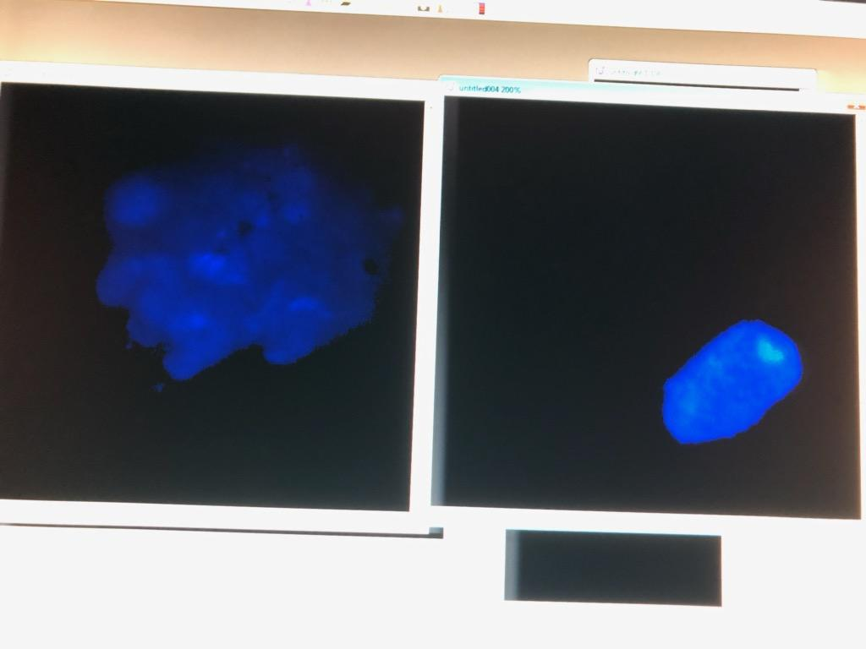
Tissue aggregates
DAPI stain
60X
No scale bar
Single nucleus
Tissue clump
Recommended treatment: optimize tissue dissociation

Slide 17
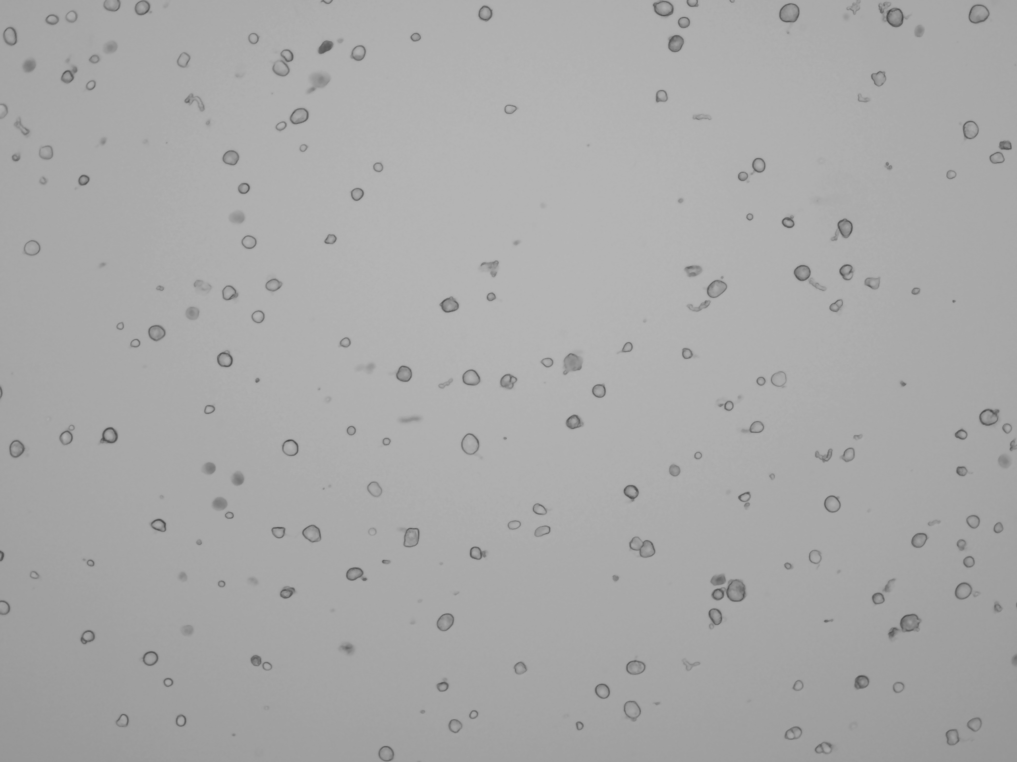
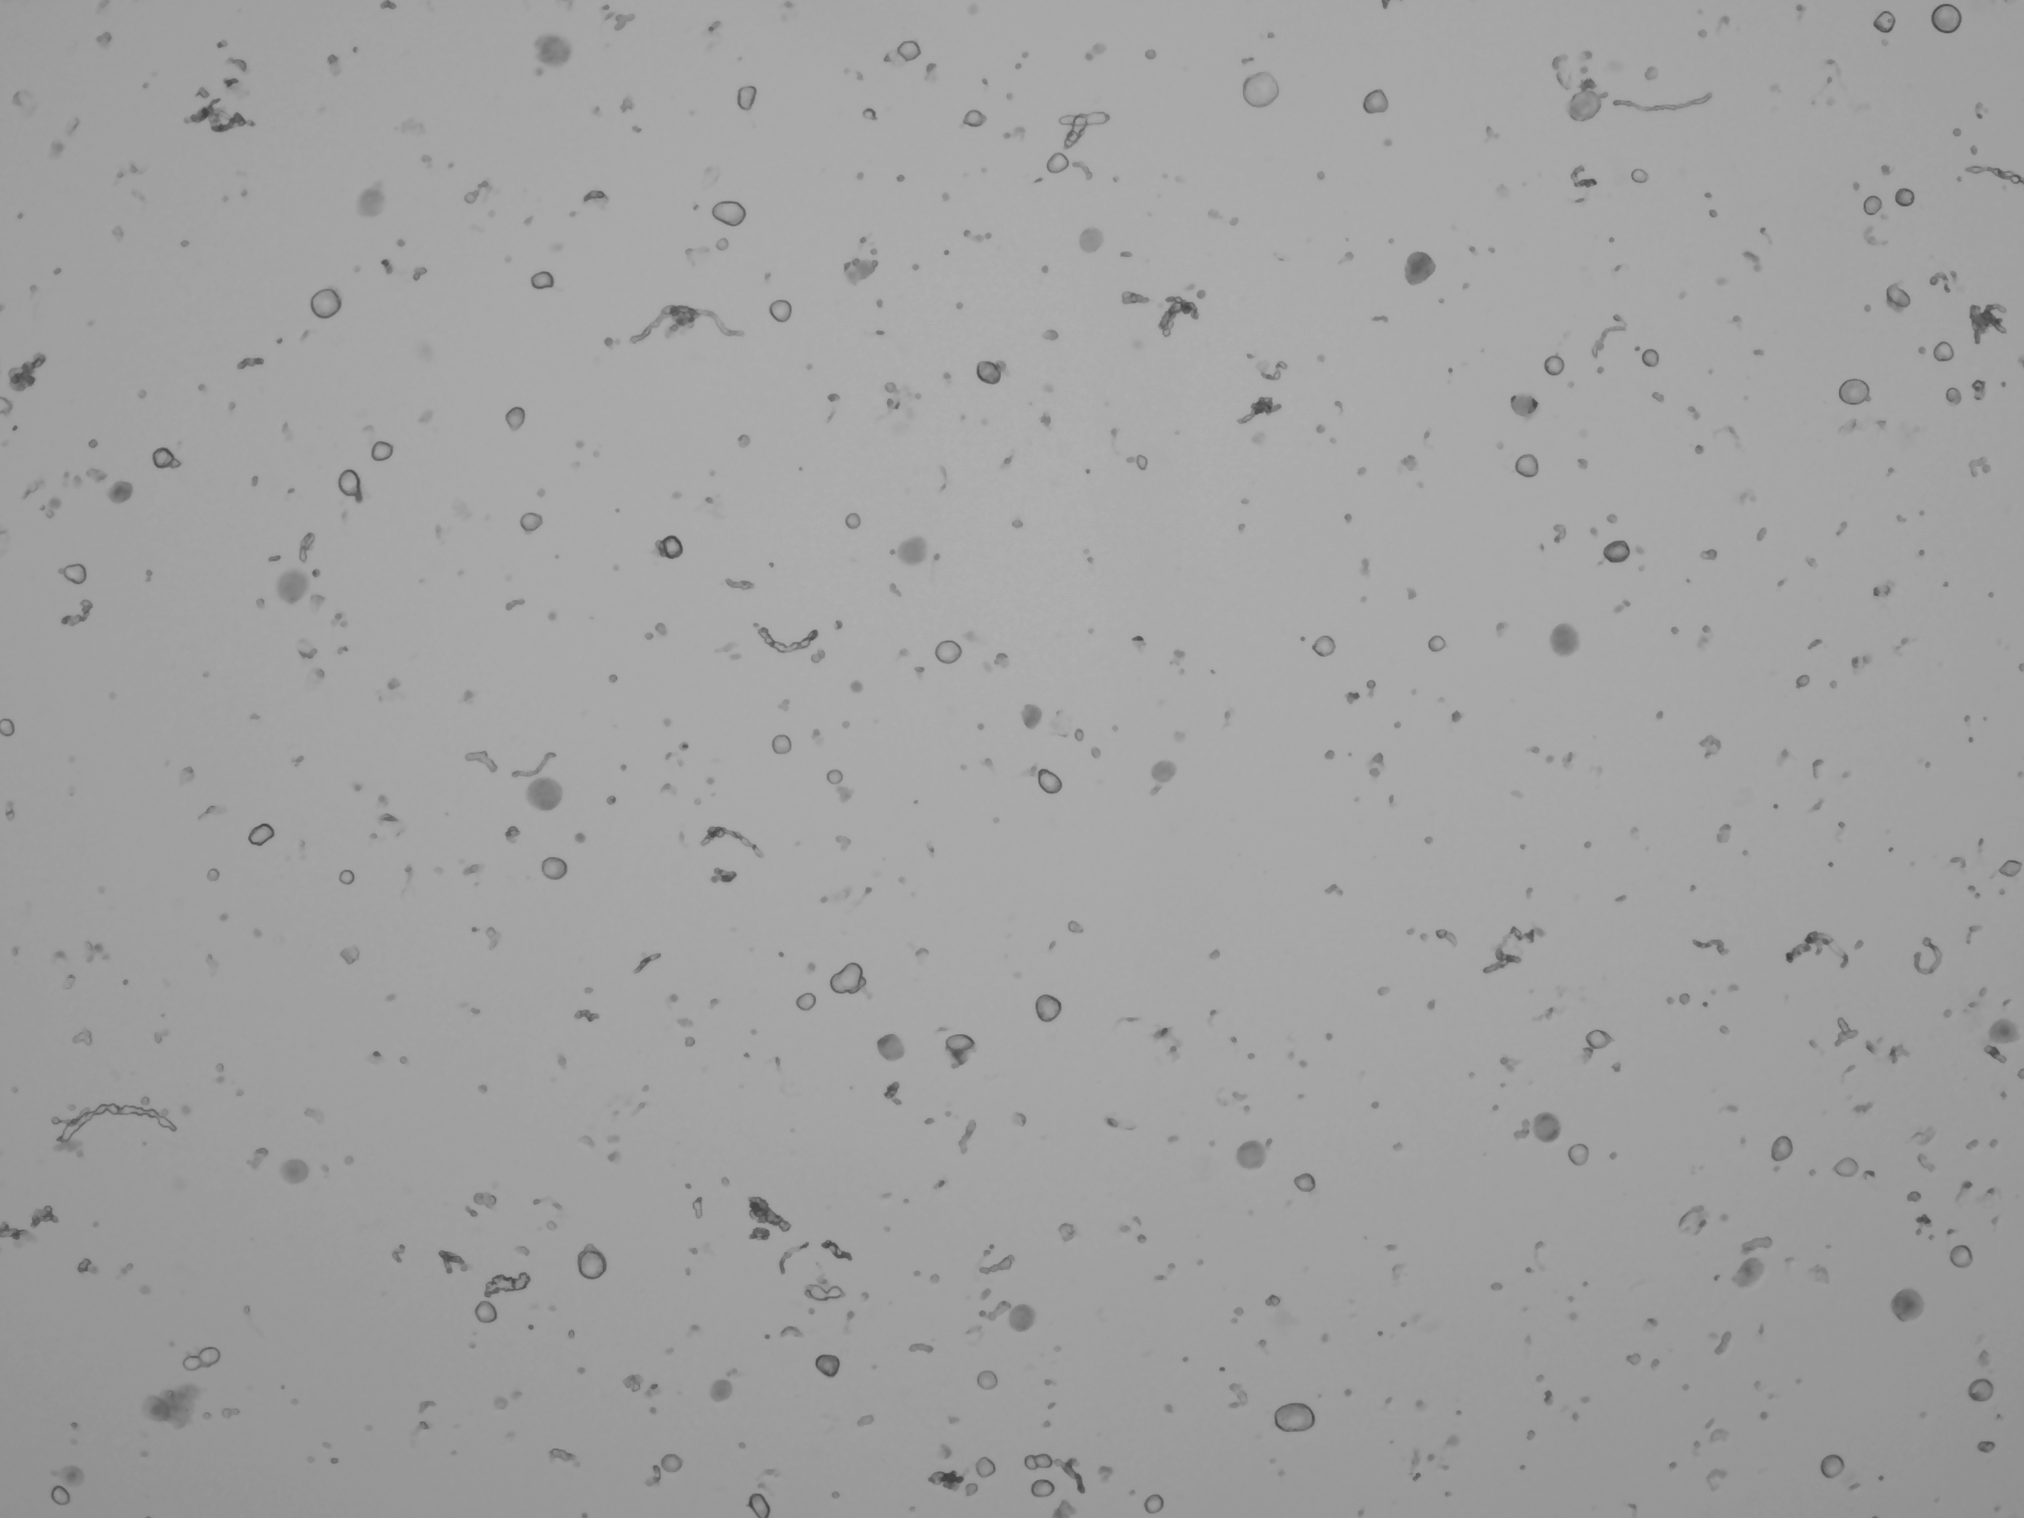
Cell debris
Mouse DRG.
Clean DRG sample Noisy sample
Recommended treatment: filtration, centrifuge, add blocking agent.

Slide 18
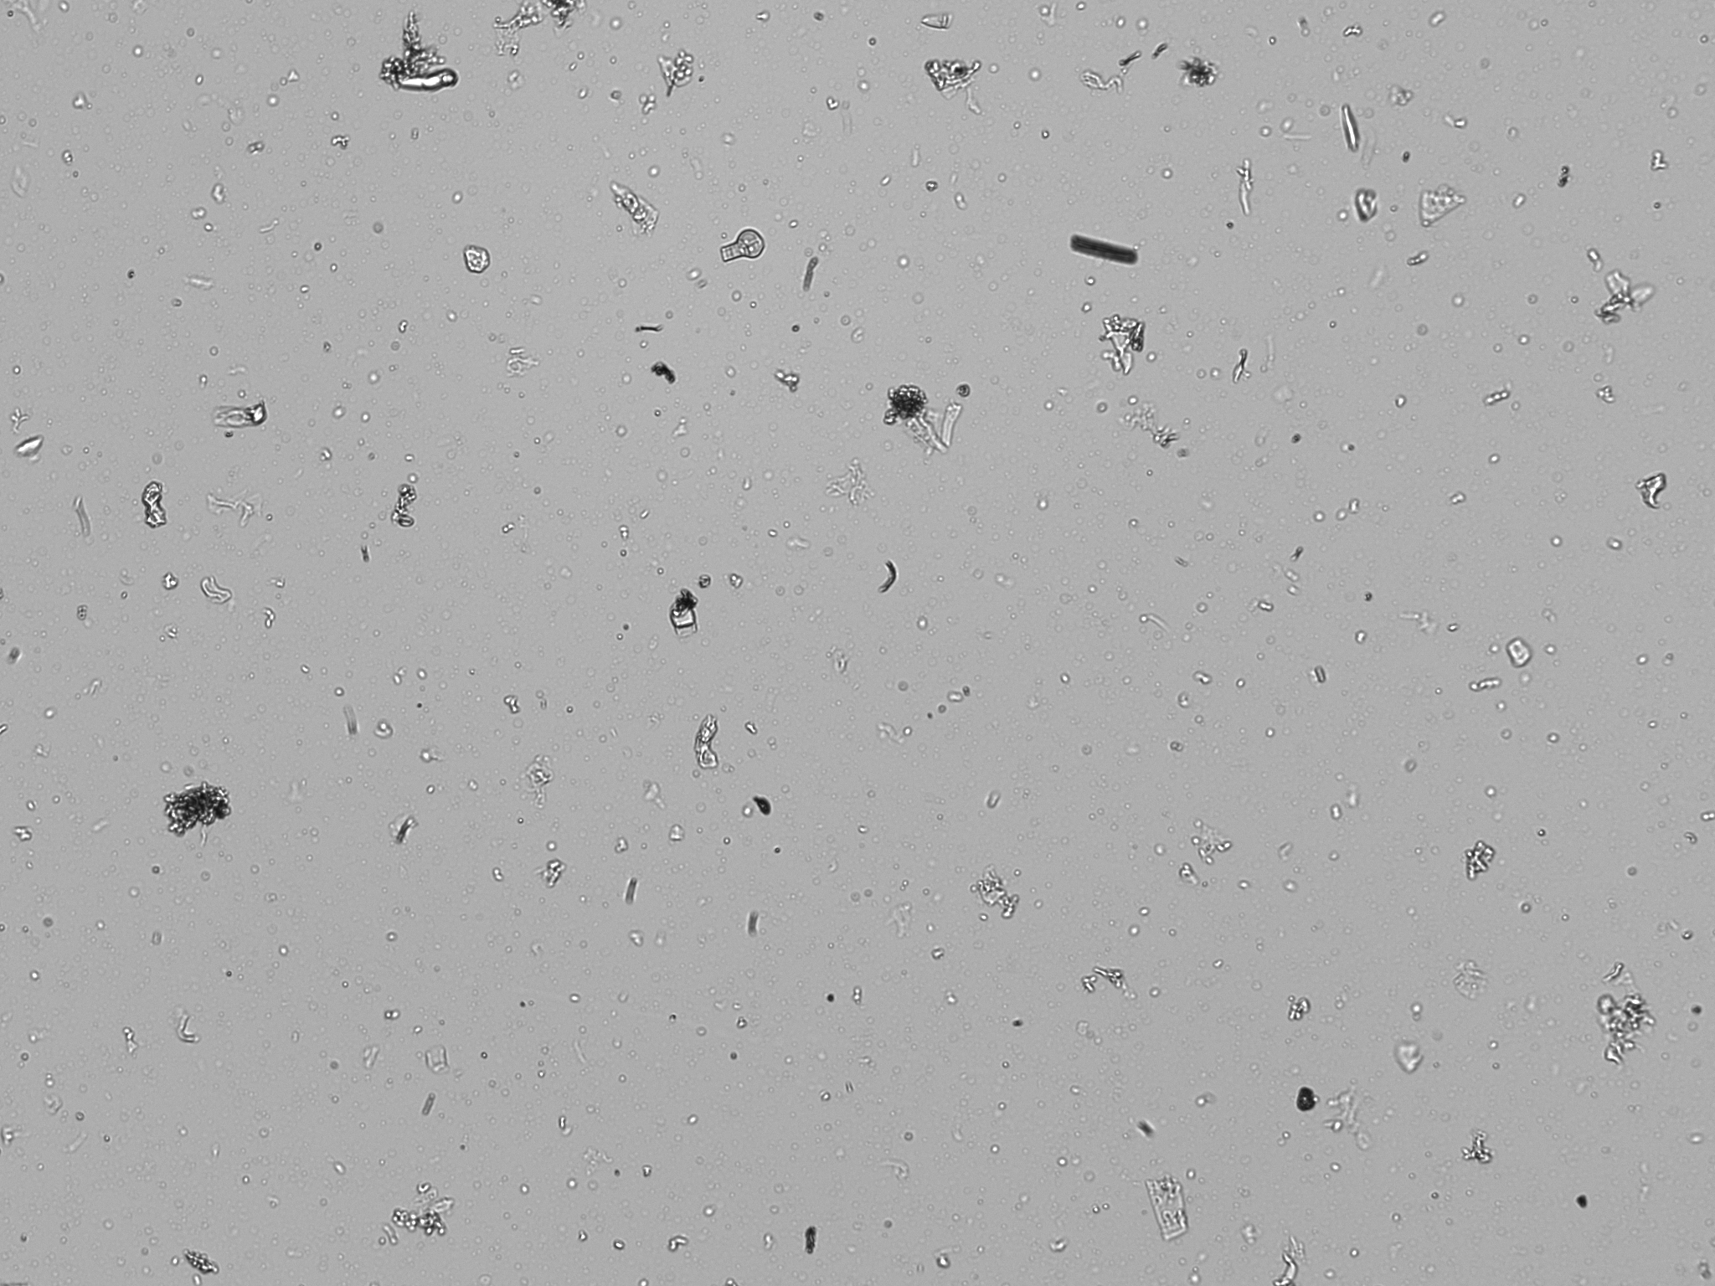
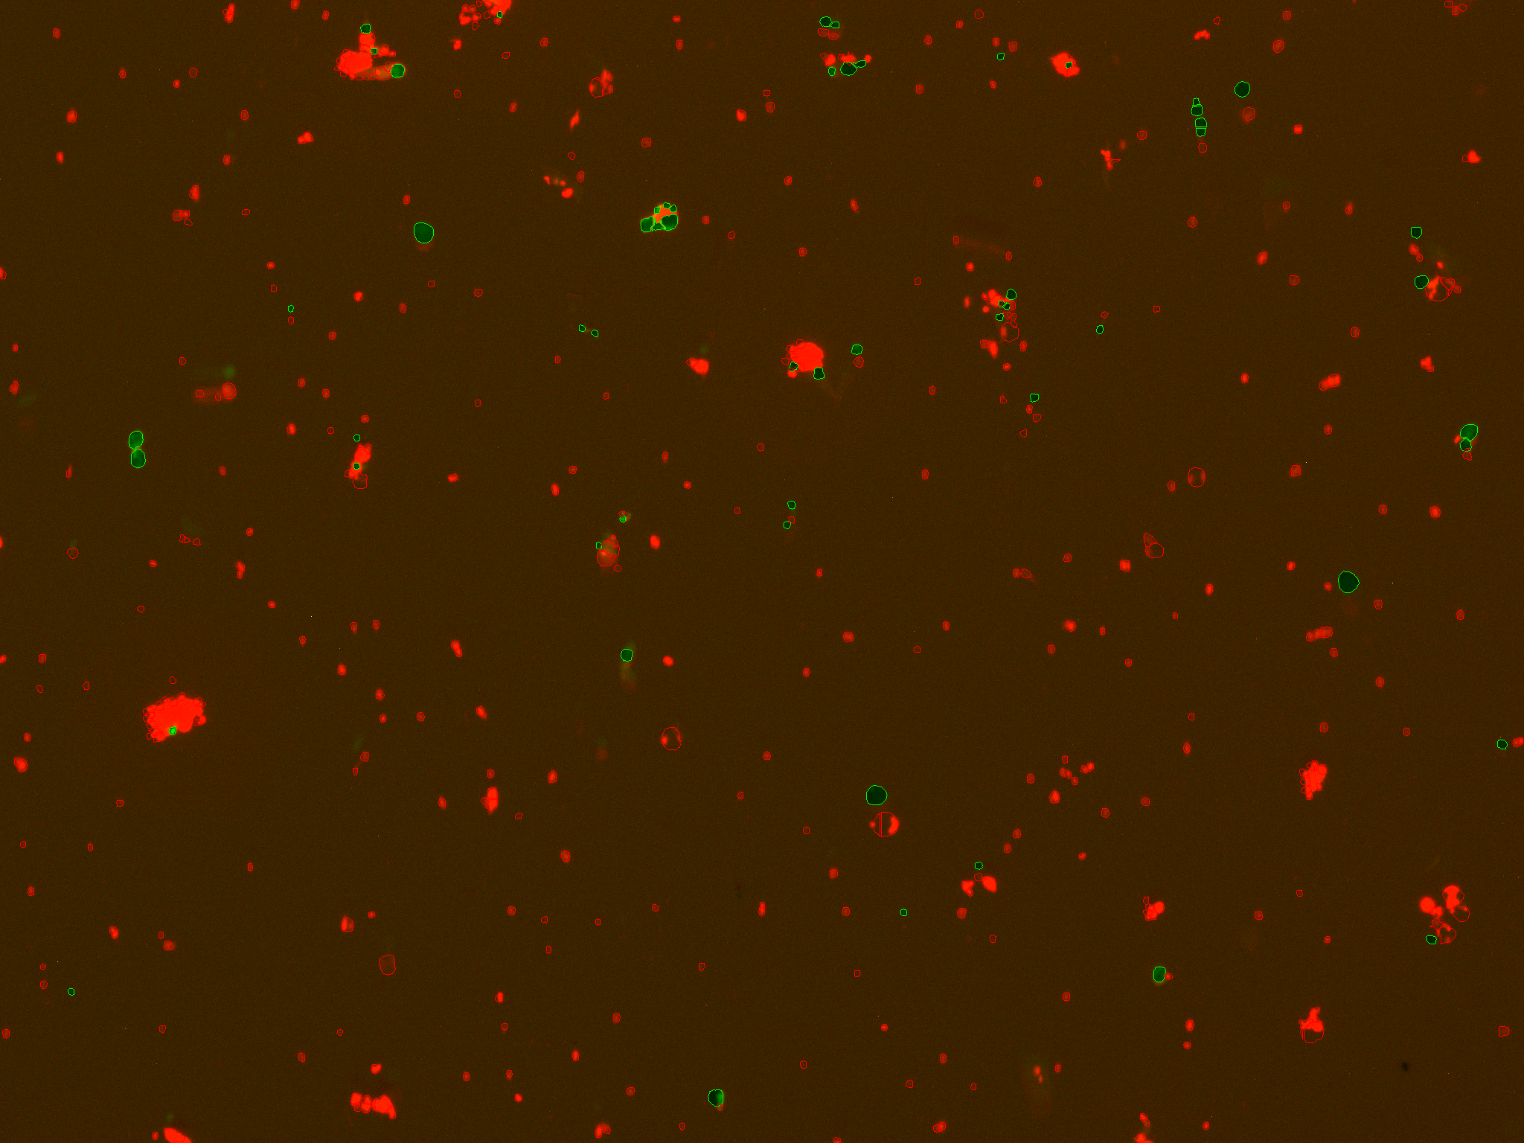
Cell debris II
Lettuce nuclei prep.
Photo credit: Mohan Prem Anand Marimuthu
Recommended treatment: modify dissociation times / detergent concentrations, change density gradient.

Slide 19
Doublets
Non-single cell clumps.
Integrated into droplets and cannot* distinguish from single cells.
Doublet
Bad for any single cell experiment.
Recommended treatment: filtration, change [blocking agent]

Slide 20
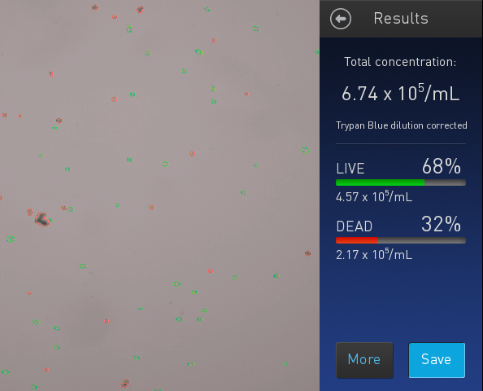

Dead cells (debris?)
Recommended treatment: dead cell removal.
https://www.miltenyibiotec.com/US-en/products/dead-cell-removal-kit.html

Slide 21
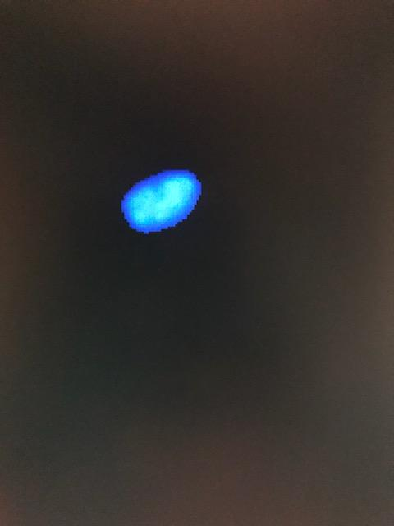

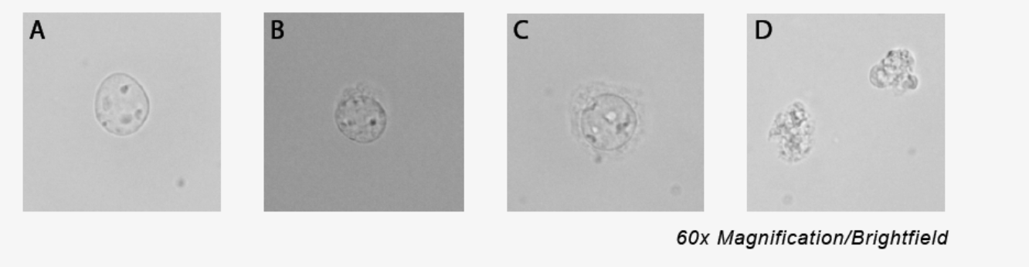
Nuclei QC
Automated cell counters suboptimal, but possible with fluorescence.
Countess II FL, Devonix CellDrop.
Stains
Trypan blue → 100% dead (not great).
Ethidium homodimer stain (good for excluding debris).
DAPI, PI other options
60X: DAPI
Credit: 10X
Hemocytometer
CountessII

Slide 22
Workflow
Single cell suspension
Visually inspect cells
Starting over >> manipulation
Filter
NO
Free of debris / live
YES
Count

Slide 23
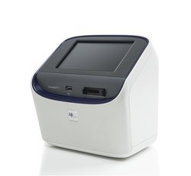
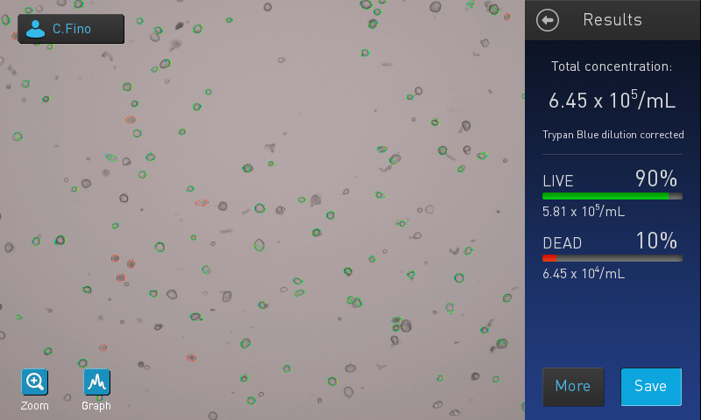
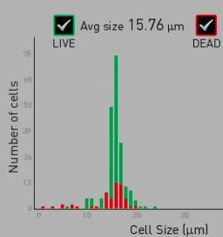
Automated counting
Countess II.
Pros (+):
Fast.
Live/dead cell counts.
Cell size estimates.
Cons (-):
Cell size limits (4-30um).
Doesn’t do well with odd cell shapes, debris, nuclei.

Slide 24
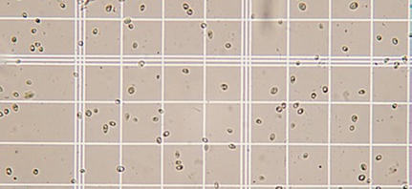
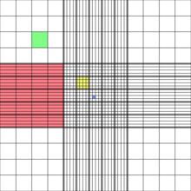
Manual counting
Hemocytometer.
http://www.wetnewf.org/pdfs/hemocytometer.html
Pros (+):
Reliable cell counts.
Count small cells.
Visualize cells vs. debris.
Cons (-):
Slow...

Slide 25
Cell sorting
FACS
Pros (+):
Sort live / dead.
Enrich cells of interest.
Determine whether correct cells isolated (qPCR works too).
Cons (-):
Overestimates cell counts (~2x).
https://flowcytometry-embl.de/cell-sorting/

Slide 26

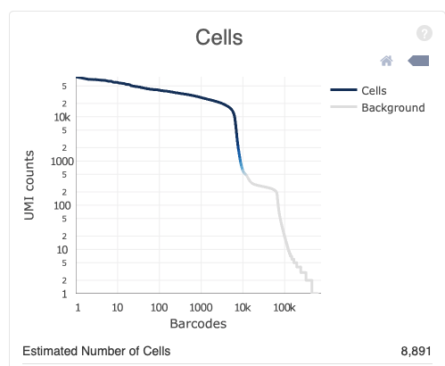

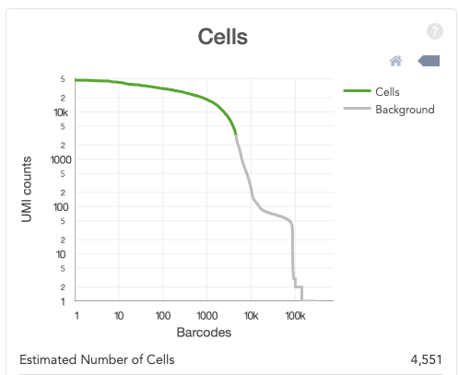
The good…

Slide 27
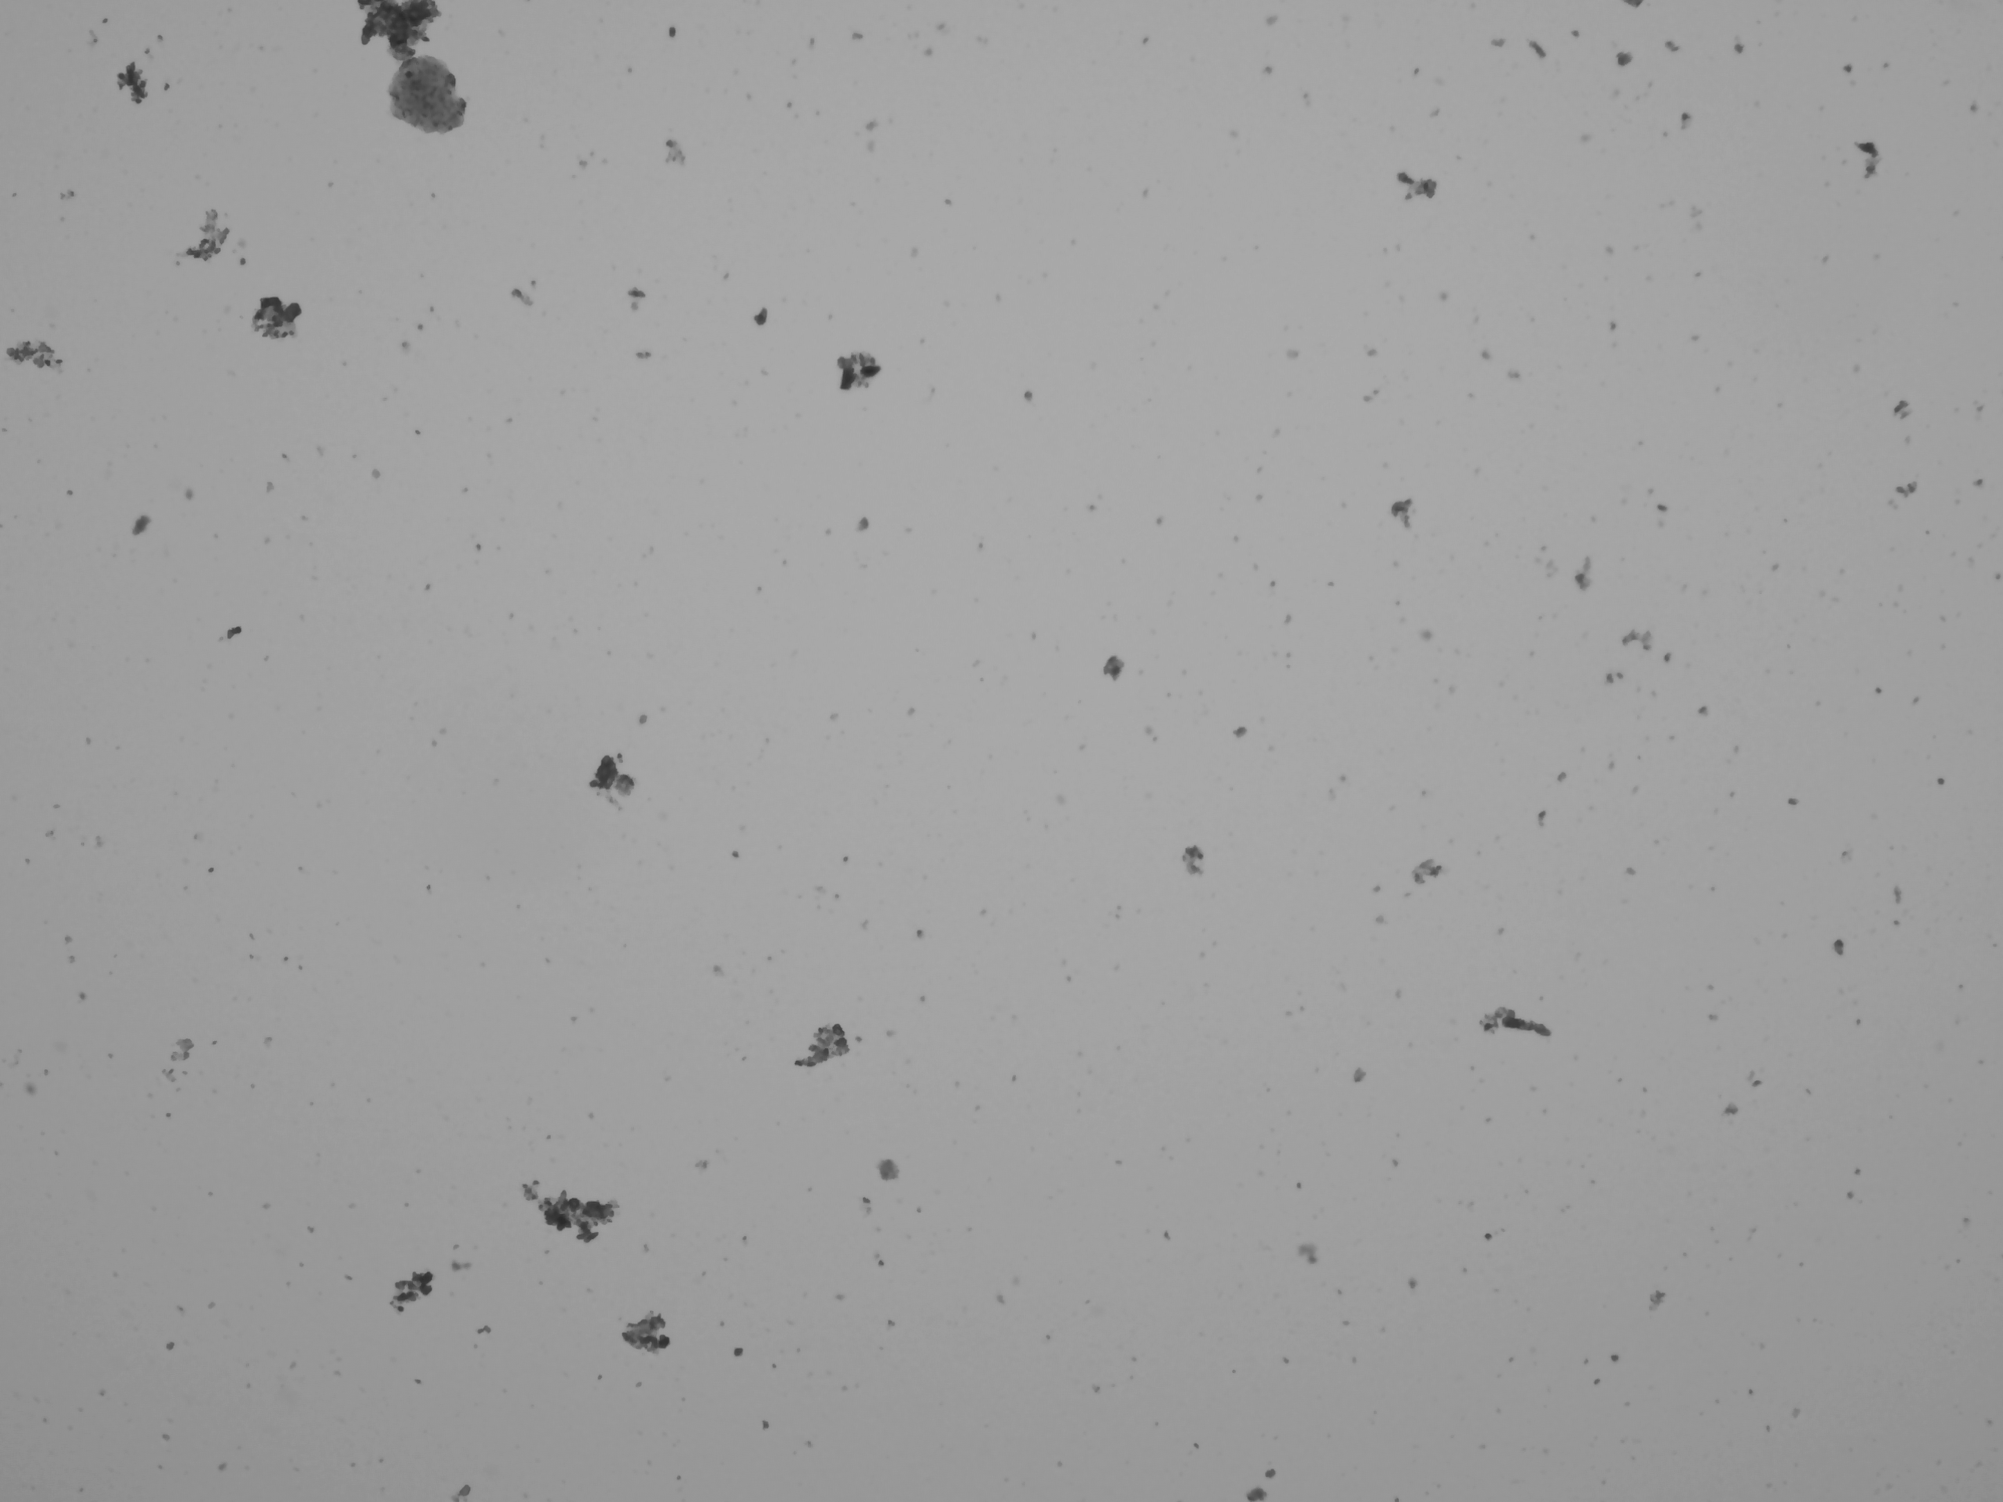
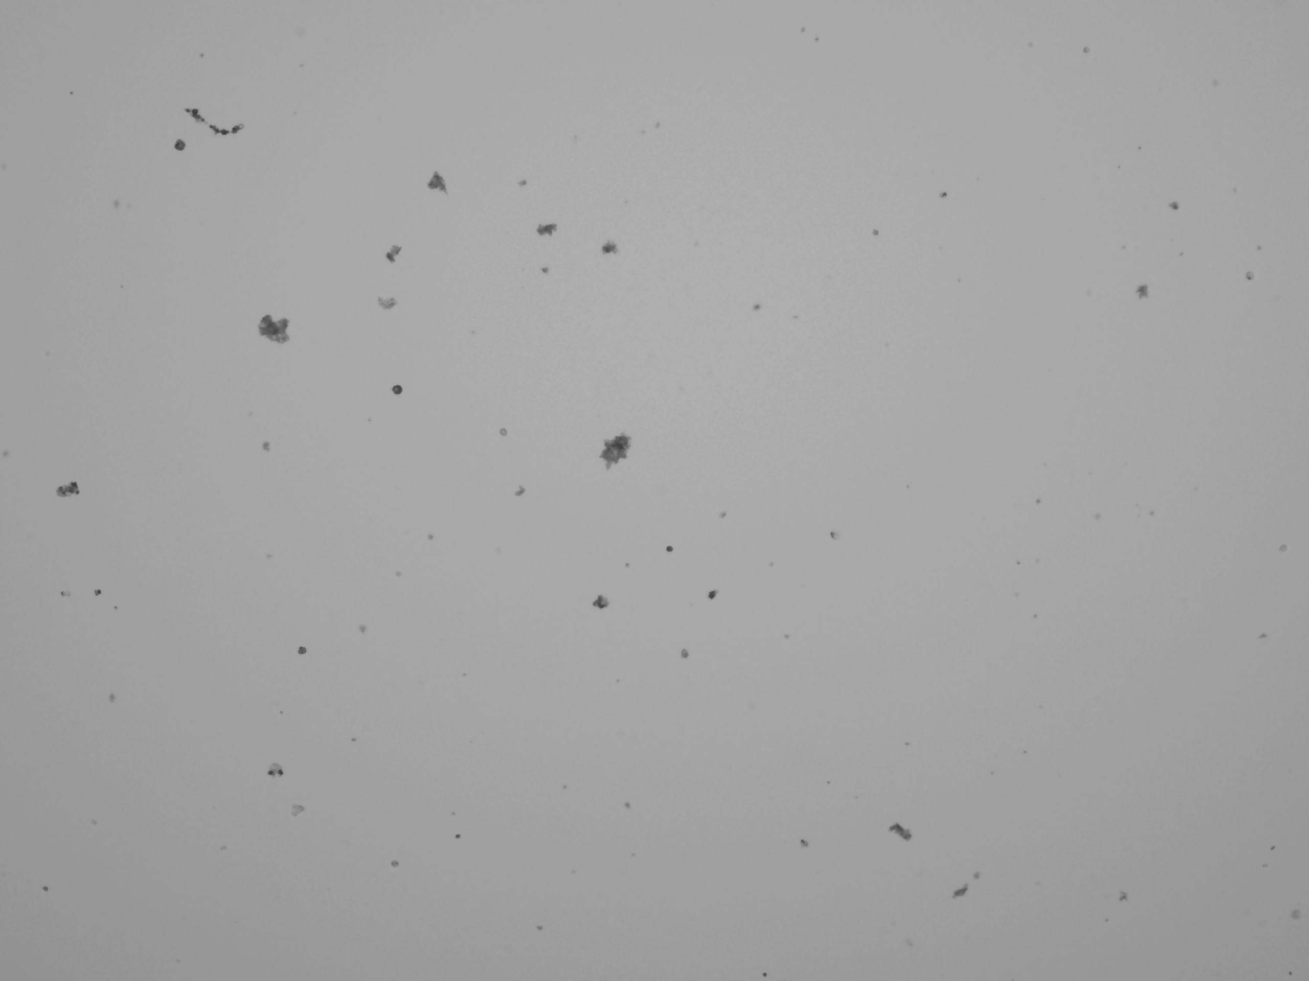

The bad…

Slide 28
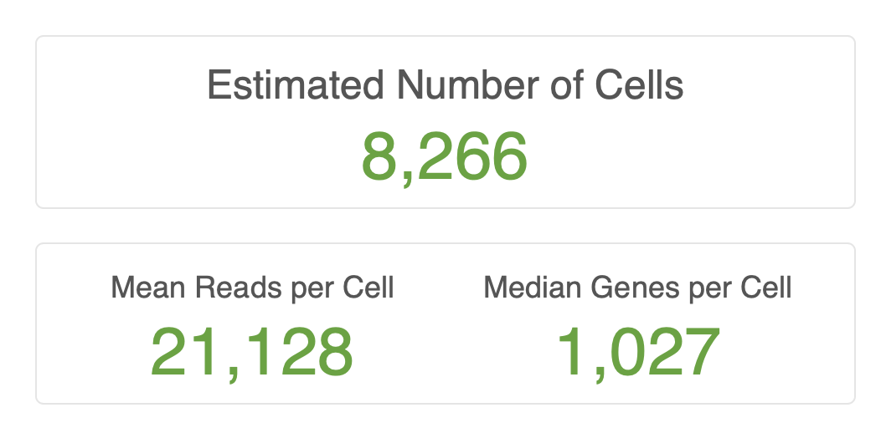



Challenges Cell Recovery
10X is optimized for model cell types – human PBMCs, etc.
Round, easy to count, size well below size of microfluidics.
These yield consistent results. 10K target. 8K-10K recovered.
But most experiments outside of culture don’t look like this.
Nuclei (100% dead)
Variable size, shape, and viability
Hydra
Human bone

Slide 29
How maximize output?
Carefully craft experimental design and sample prep .
QC cells before real sample set-up.
Concentration: aim for the median.
700-1,200 cells per µl optimal.
Too high → dilute.
Too low → tough one (concentration impacts yield, pooling replicates suboptimal).
Count in replicates (at least n=2).
Viability: 70% minimum.
Nuclei and methanol fixed cells (0%).
Treat cells gently.
Wide bore pipette tips, keep cells at preferred temp, work quickly..

Slide 30
Overview
Why single cell?
Methods – SC isolation
Single cell isolation
Single nuclei
Methods - sample QC
Do I have single cells?
Are they alive?
Are they too big?
Did I isolate the correct cells?
Cell labeling
Single cell studies at DNA Tech

Slide 31
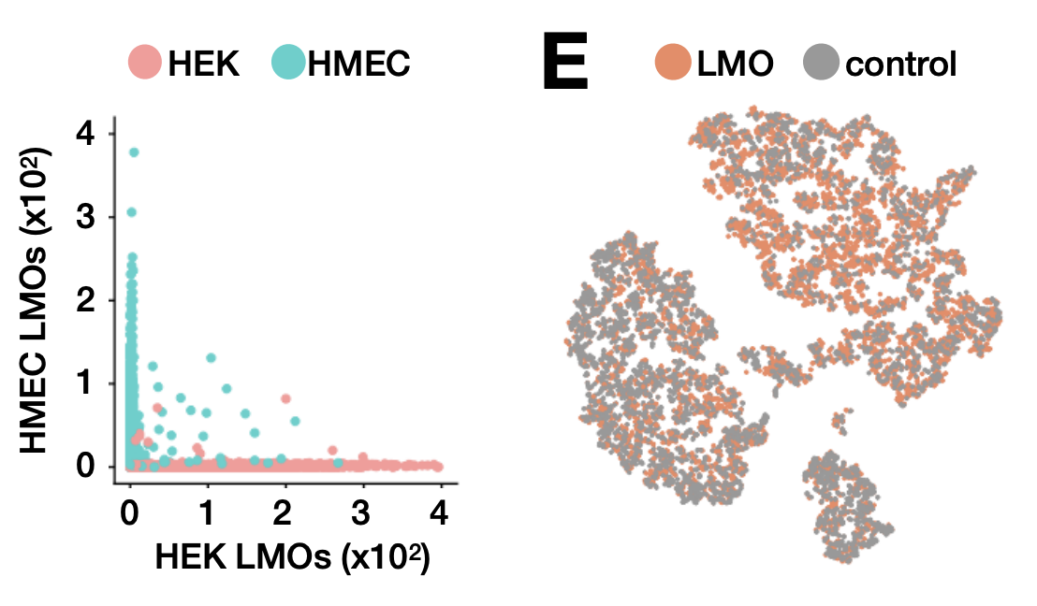
Cell Hashing
Label cells (either oligo-tagged antibodies) or oligos.
Allows for multiplexing and super-loading scRNA-seq platforms – cost saving and minimize tech variation.
Many options available:
MULTI-seq (C. McGinnis / Z Gartner @ UCSF)
Biolegend TotalSeq
BD Single-Cell Multiplexing Kit
10X CellPlex (coming later this year)
“MultiSeq”
“Cite-seq”

Slide 32
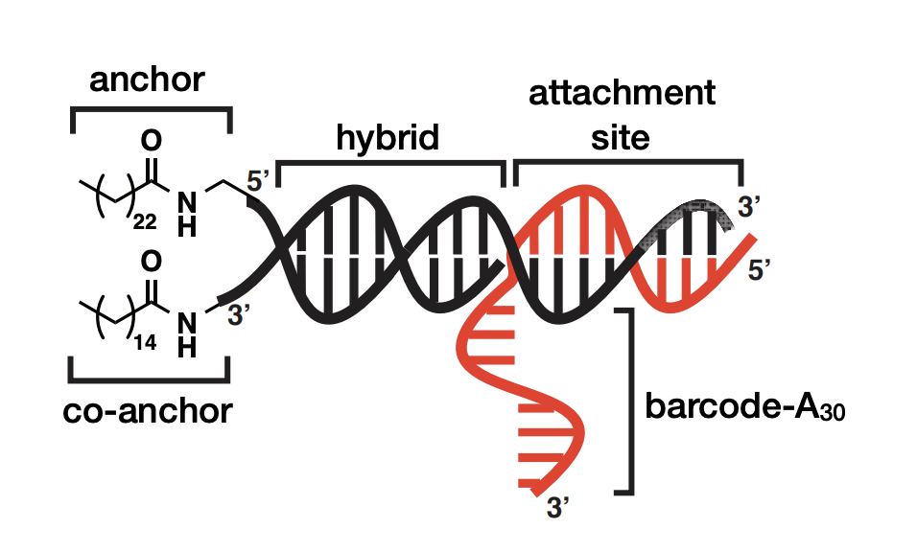
MultiSeq Tag Design
Oligo targeted to plasma membrane with 5’ lignoceric acid amide.
Co-anchor increases stability and specificity.
8bp barcode conjugated to 3’ Poly-A capture sequence.
Once in droplets, PolyA mimics endogenous transcripts and hybridizes to dT oligos in beads.
5’
PCR handle
barcode
AAAAAAAAAA
3’
Barcode --> tag suspension
AAAs → capture transcripts
“MultiSeq” (C. McGinnis)

Slide 33
Overview
Why single cell?
Methods – SC isolation
Single cell isolation
Single nuclei
Methods - sample QC
Do I have single cells?
Are they alive?
Are they too big?
Did I isolate the correct cells?
Cell labeling
Single cell studies at DNA Tech

Slide 34
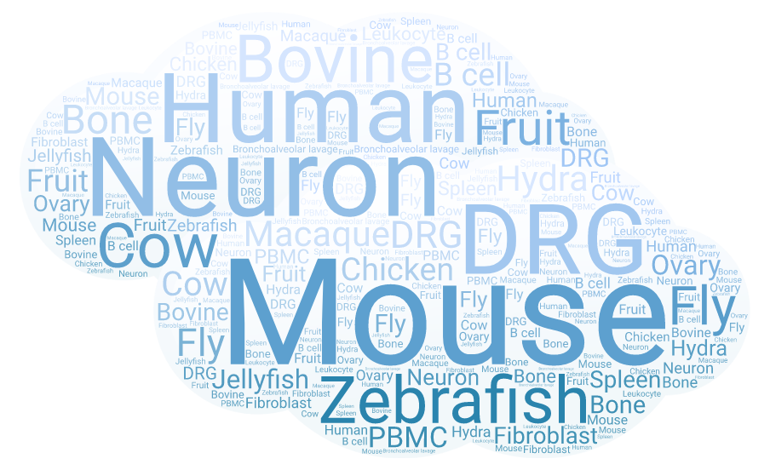
10X Single Cell Studies - DNATECH

Slide 35
Assay summary (organism)
78 projects since July 2017 (primarily 3’ GEX).
Sample distribution by organism
Bovine
Human
Mouse

Slide 36
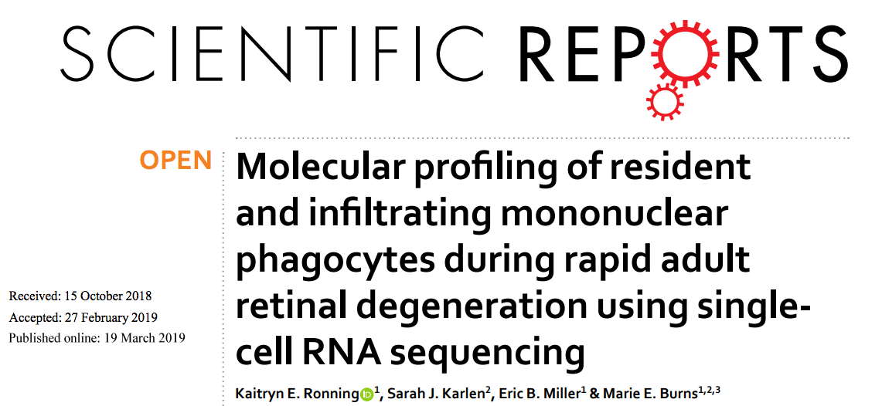
Retinal degeneration

Slide 37
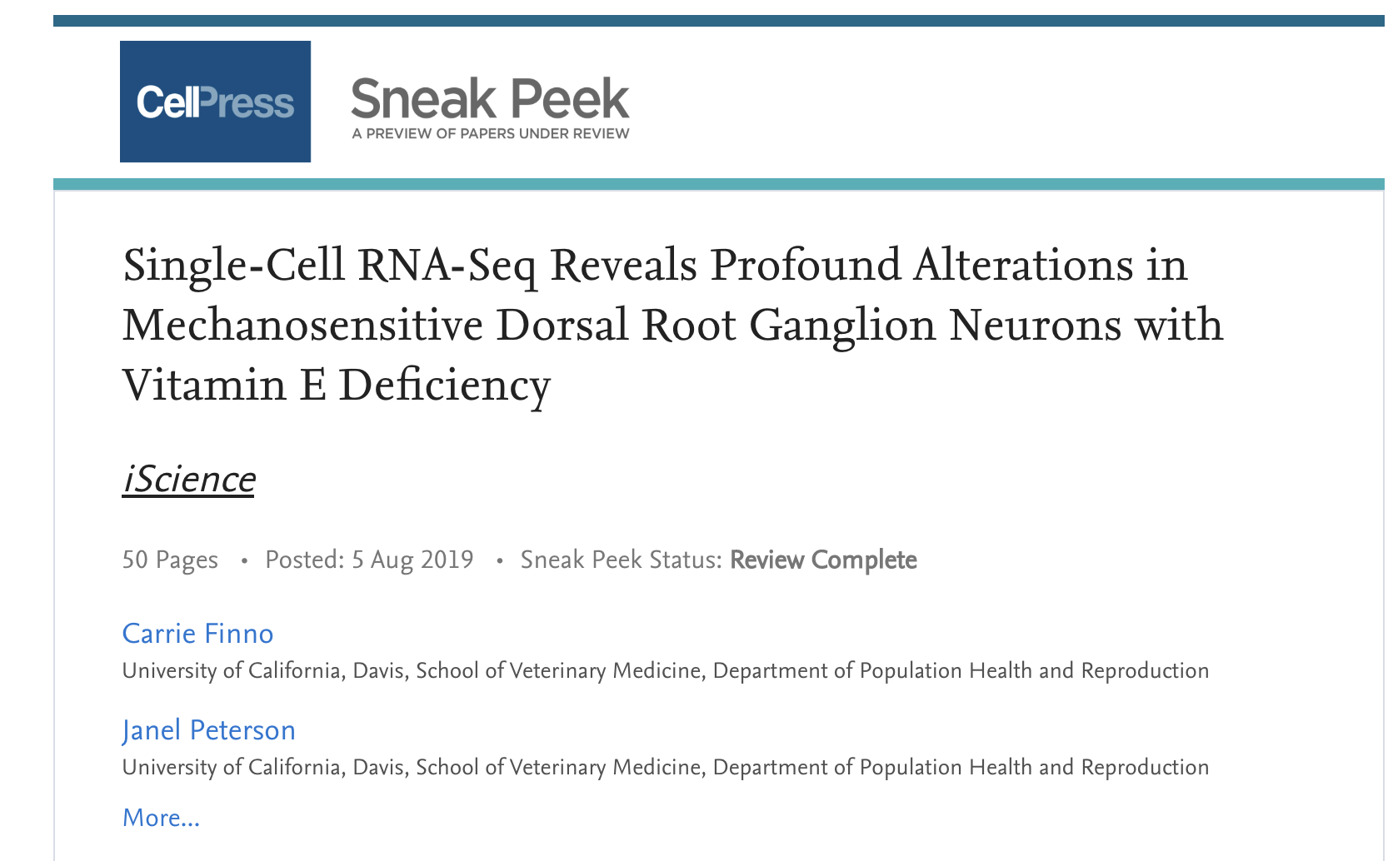
Vitamin E deficiency - DRG Neurons

Slide 38
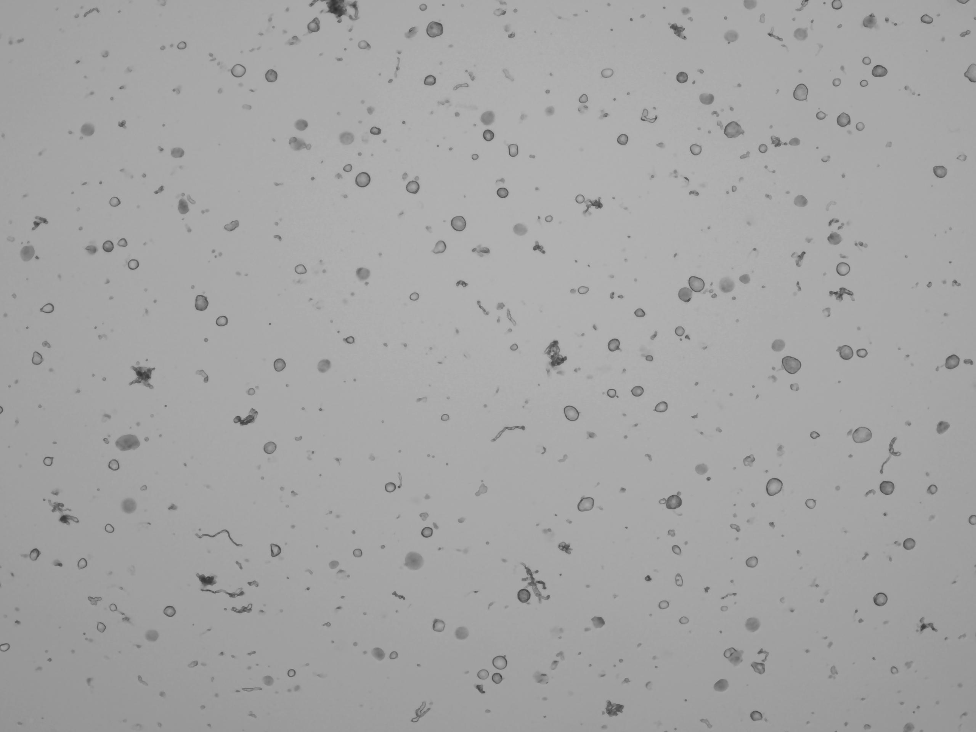
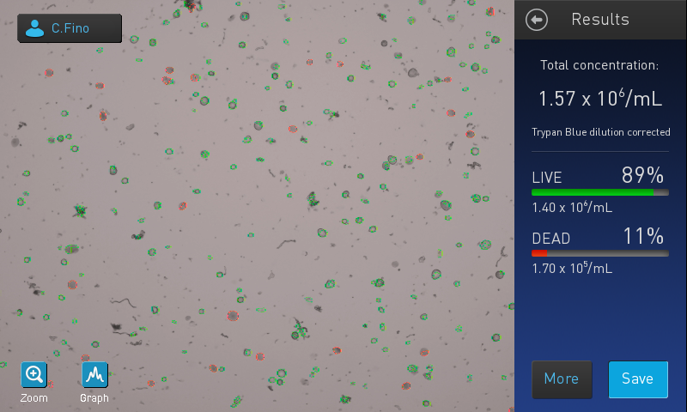
‘564’ – challenges and solutions
DRG fragile, difficult to count, odd sizes (clog 10X chip?).
Count manually → better counts.
Accepted some degree of induced technical variation
Prepped samples over three days.
Improved sample quality and reproducibility, introduced prep day variation.
As Matt mentioned mitigate with experimental design.

Slide 39
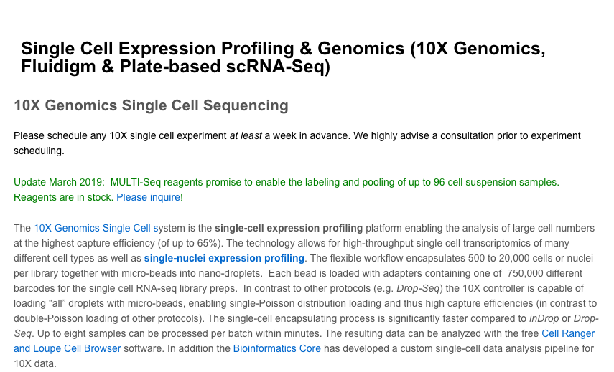
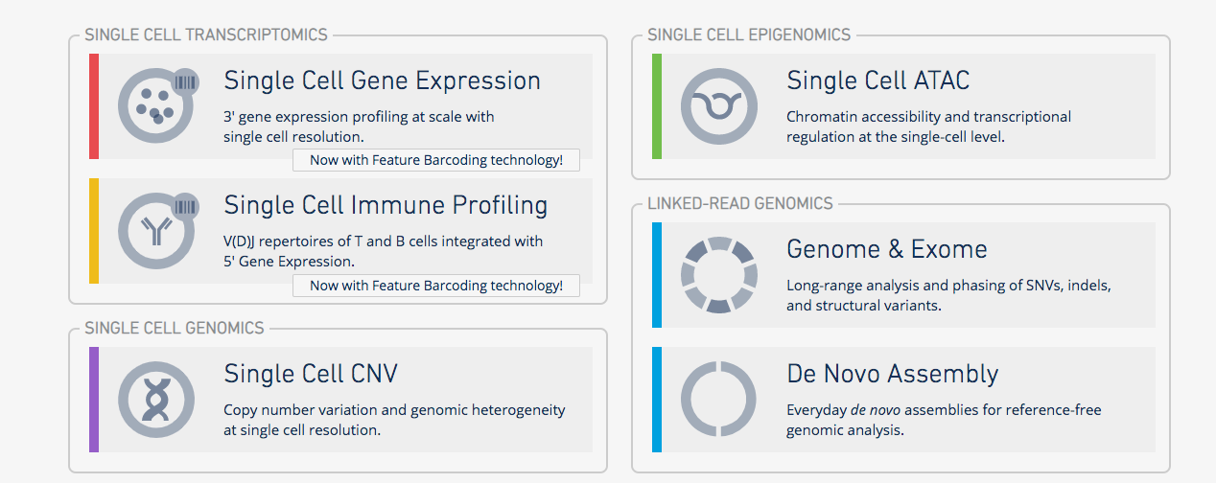
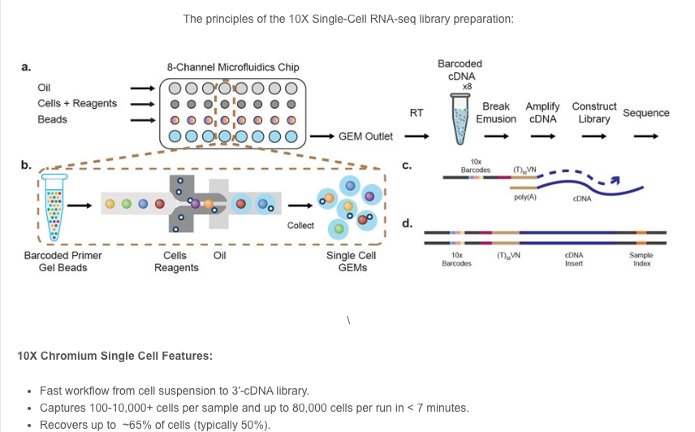
Important resources
10X Genomics
https://support.10xgenomics.com/single-cell-gene-expression
Paul Scott, Sales Executive (paul.scott@10xgenomics.com)
UC Davis Flow Cytometry
http://www.ucdmc.ucdavis.edu/pathology/research/research_labs/flow_cytometry/index.html
Bridget McLaughlin (Technical Director)
UC Davis DNA Technology Core
http://dnatech.genomecenter.ucdavis.edu/single-cell-analyses/
UC Davis Bioinformatics Core
https://bioinformatics.ucdavis.edu/

Slide 40
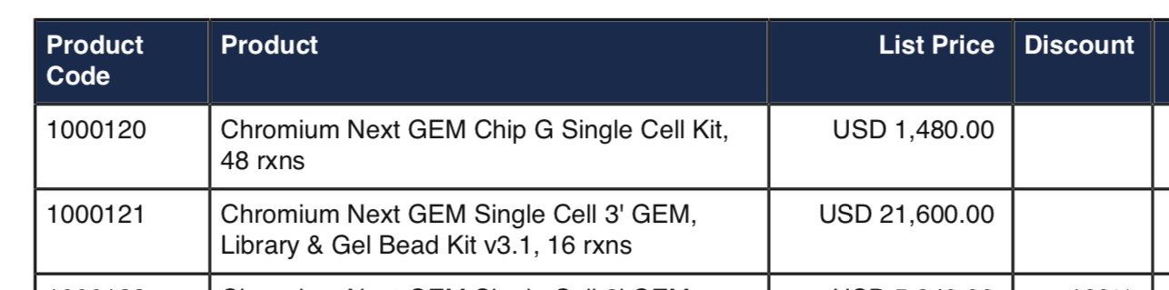
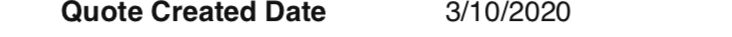
Cost 10X Reagents
Chips are single use (n=1 to n=8 samples) → $247 EACH
Reagents (n=1) → $1,350 EACH.
Total (n=1, reagents only): $1,597.
This doesn’t include you or your cores labor!
Sequencing? Bioinformatics?
Depends on many factors.
We charge $1,000 for 350M reads (~10K cells with 35K reads per cell).

Slide 41
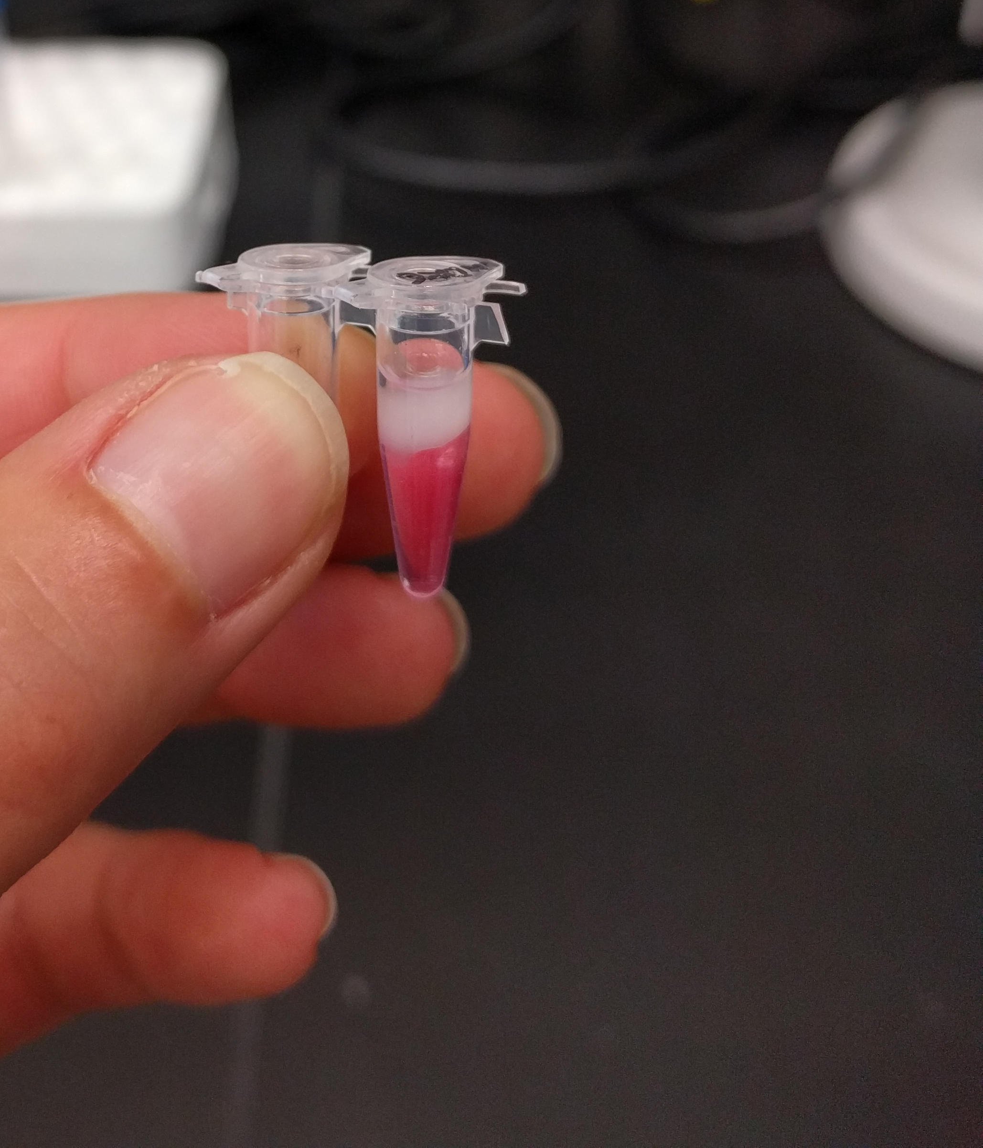
Acknowledgements
UC Davis DNA Technology Core team.
UC Davis Bioinformatics Core team.
10X Genomics.
Adam Bemis (Field Applications Scientist)
Paul Scott (Sales Executive)

